Slide 1
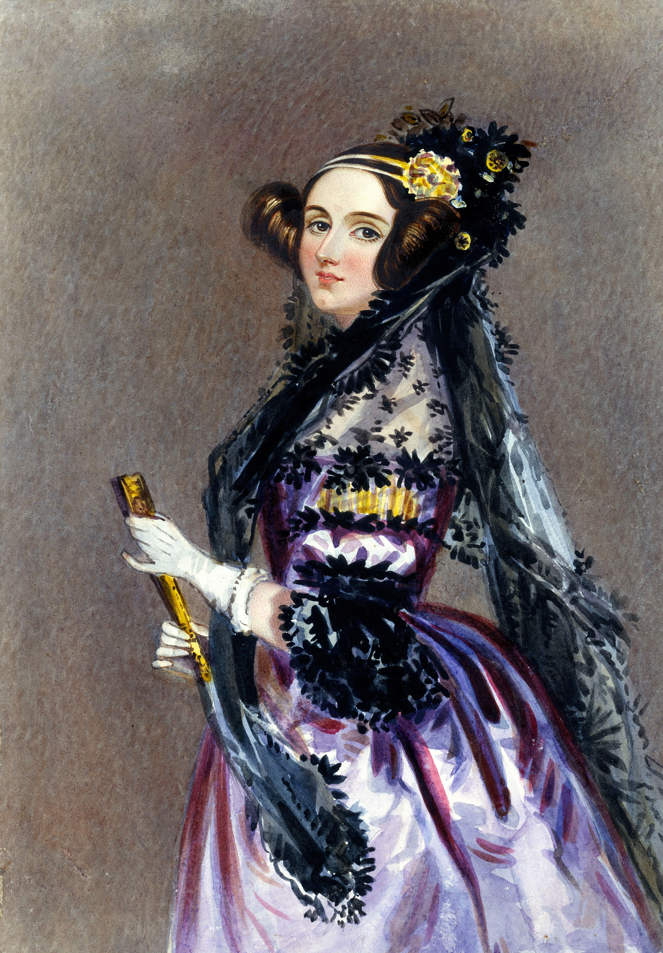
Personal Voıce assıstant (ADA)
​

Slide 2
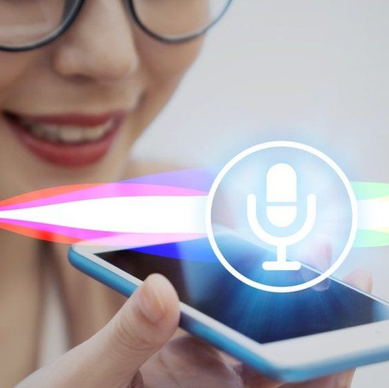
ABOUT ADA
ADA is a voice assistant, a product of artificial intelligence, that answers your personal questions, can chat with you, and instantly respond to the questions you need answers to when you need help. Our voice assistant is named after Ada Lovelace, who is recognized as the world's first computer programmer. Let's start getting to know our voice assistant, Ada.

Slide 3
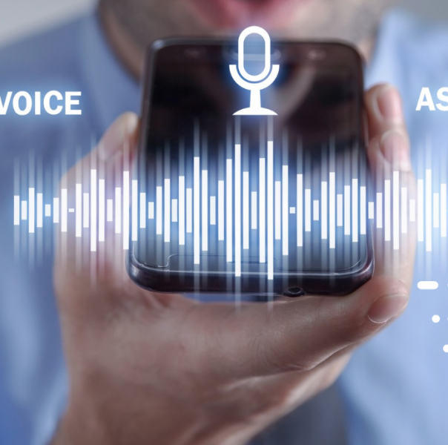
FEATURES
ACCESS
When you say anything you want to access, it instantly tells you or directs you to the information you want.
CHATTING
She listens to what you say, responds and chats with you.
SETTINGS
She has the ability to make settings on your computer like change the backgorund.
NEWS
Provides current news from the world and exchange rates

Slide 4
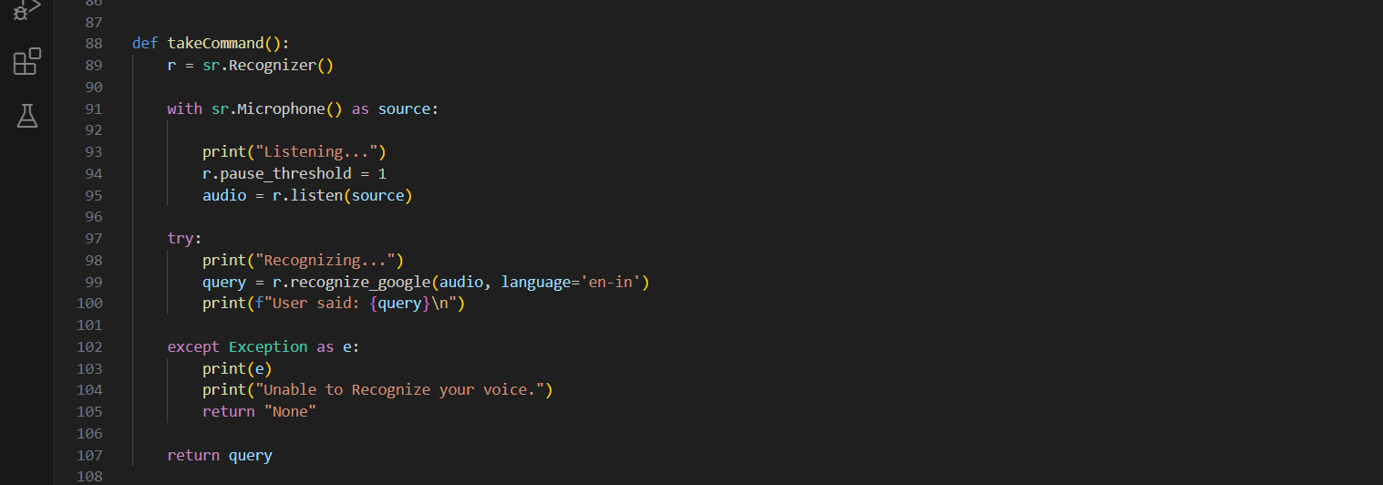
detecting sound
listens, recognizes and responds to voice

Slide 5
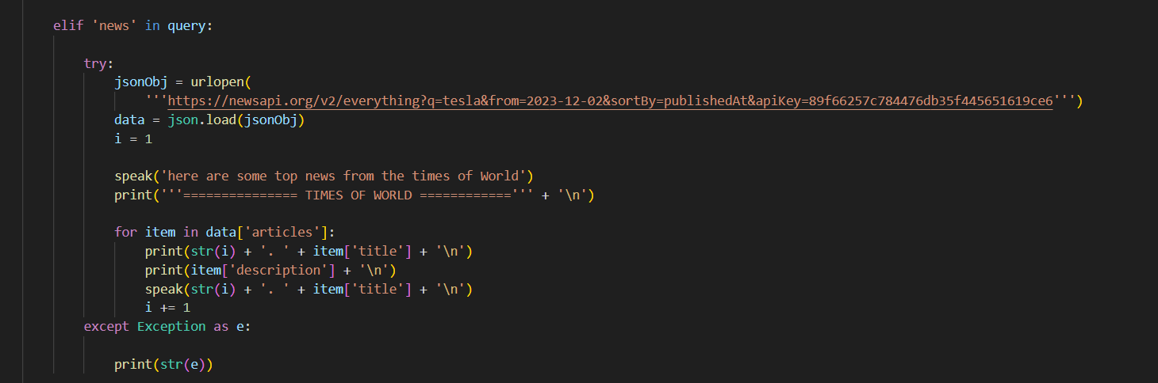
In this code, we see the news access feature. When we give the "News" command, it reads us the current news.

Slide 6
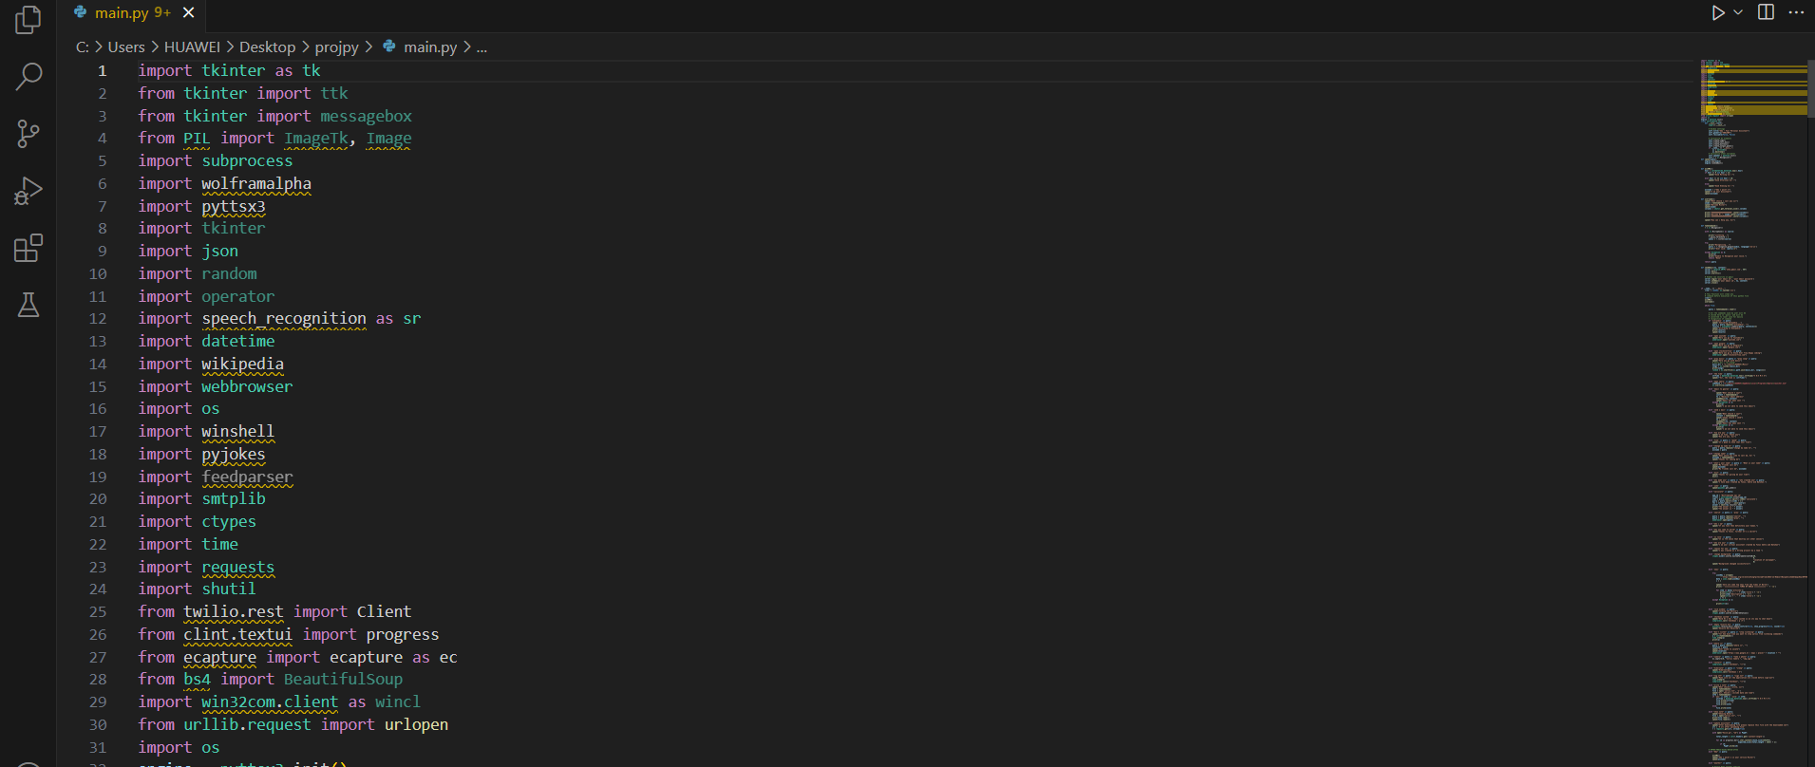
modules
Modules we created to use all features in the project

Slide 7
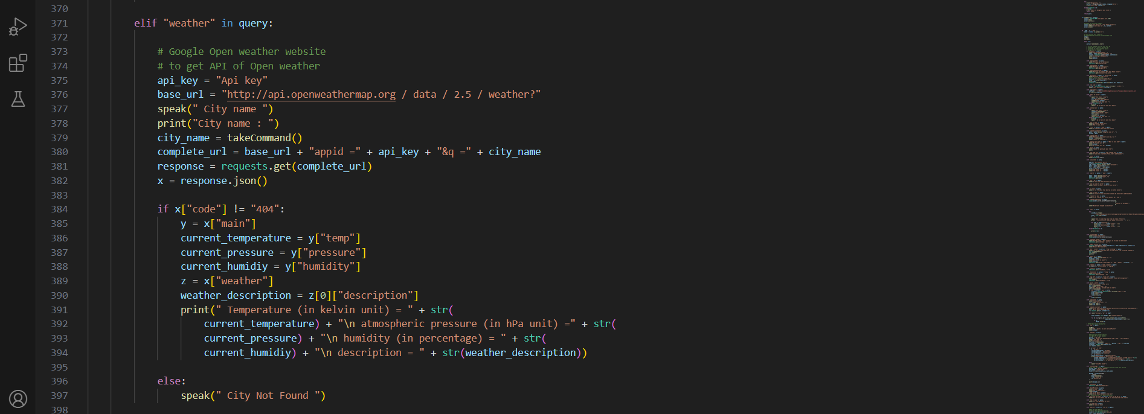
Weather apı
It shows the weather forecast and we added an API for this.

Slide 8
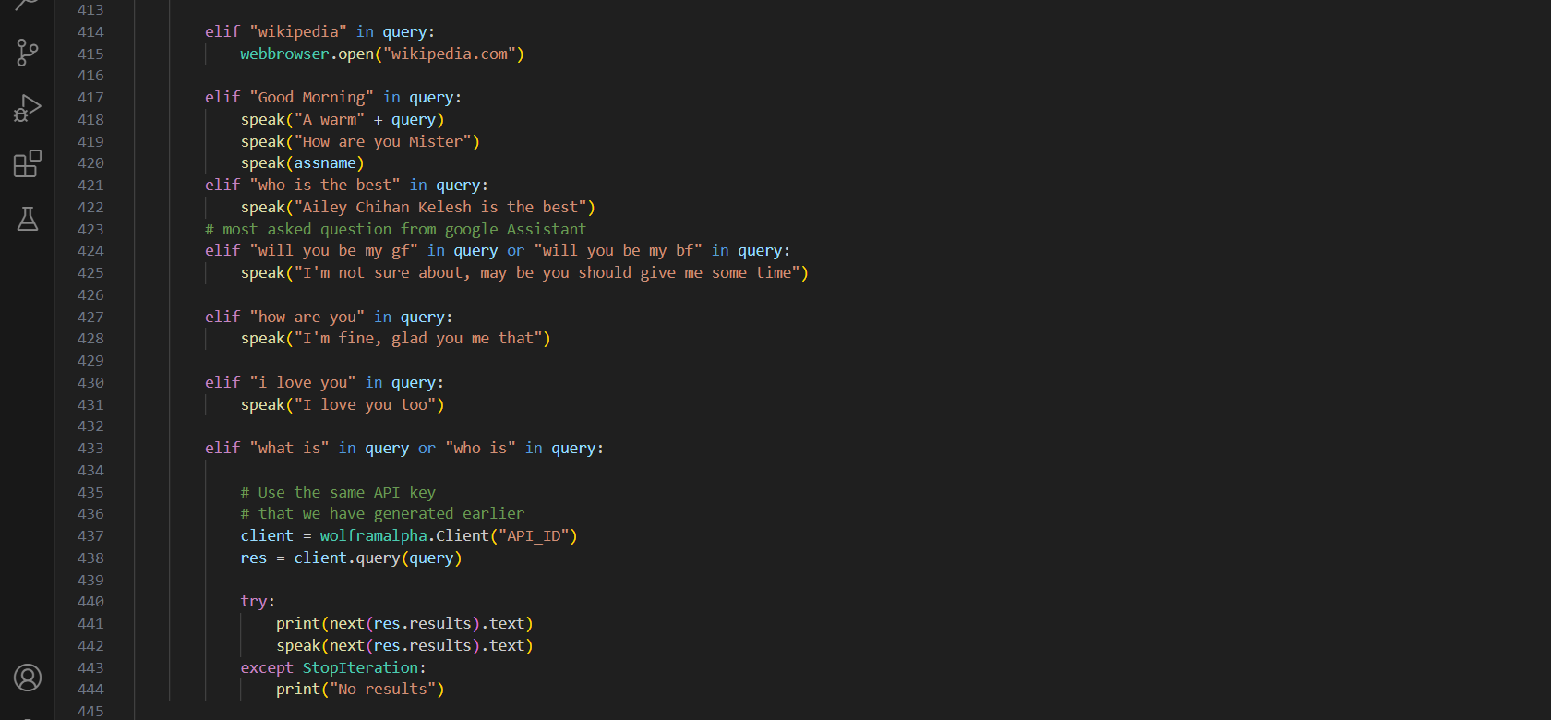
ACCESS to wikıpedıa
It is the feature of accessing Wikipedia. When the Wikipedia command is given, it opens Wikipedia.

Slide 9
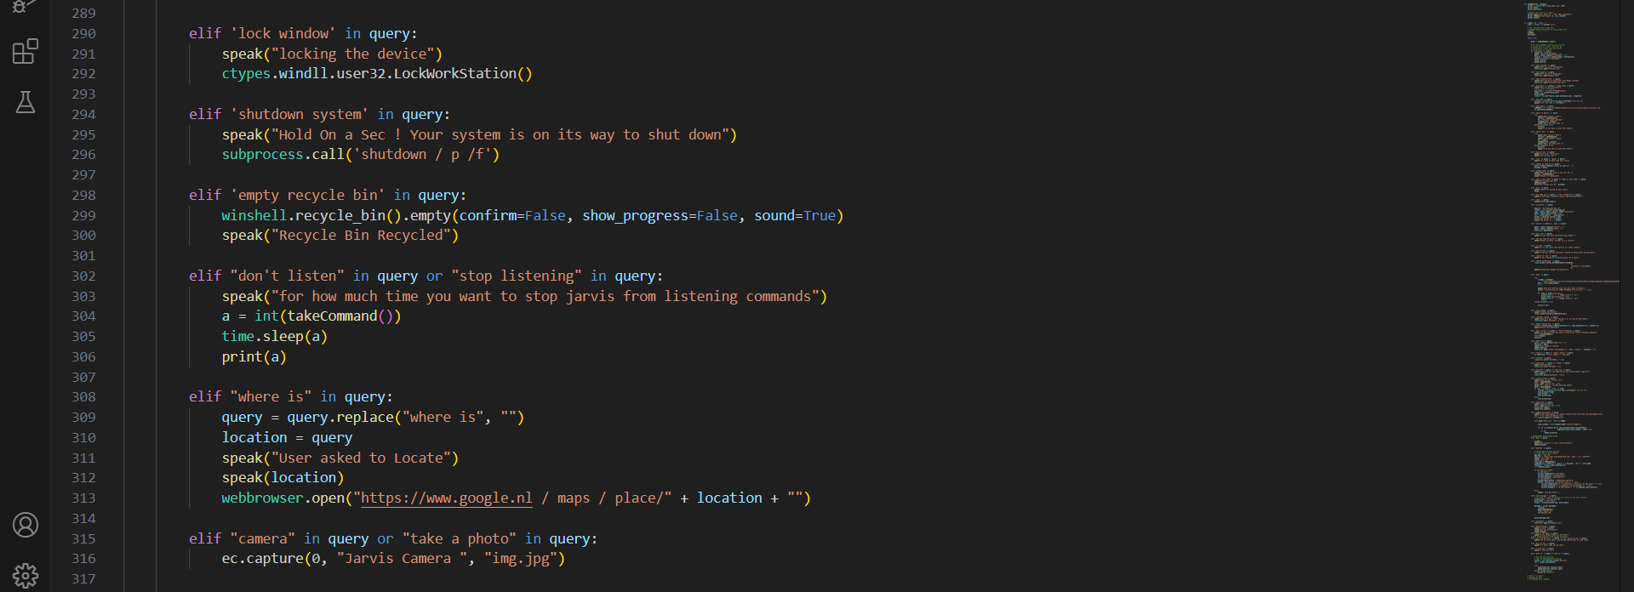
SYSTEM COMMANDS
Commands related to turning the system on and off

Slide 10
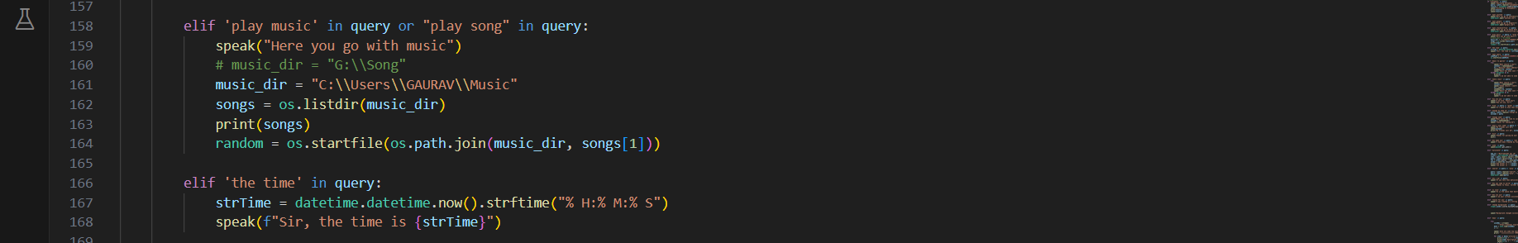
Play music
When you say play music or play song, it plays the music you want.

Slide 11
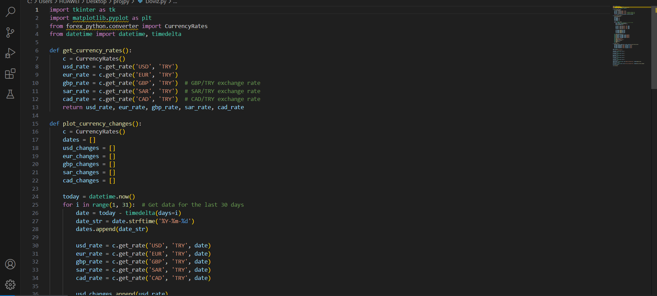
Exchange rate
Shows the daily exchange rate

